Slide 1

NexLattice: Secure, Plug&play Offgrid
Wi-Fi Mesh for IoT
Under the Guidance of
Dr. Debashis Dev Misra
Associate Professor
Faculty of Computer Technology
Assam down town University
Guwahati-26, Assam.
Submitted by
Debayangshu Sen
Roll No.: ADTU/2022-26/BCS/049
B.Tech CSE 7th Semester
Vivek Upadhaya
Roll No.: ADTU/2022-26/BCS/048
B.Tech CSE 7th Semester
Rajdeep Roy
Roll No.: ADTU/2022-26/BCS/046
B.Tech CSE 7th Semester

Slide 2
Contents
Introduction ………………………………………………………………………………………………………………………………...…..3
Problem Statement ……………………………………………………………………………………………………………………………4
Theoretical Study ……………………………………………………………………………………………………………………………...5
Motivation ………………………………………………………………………………………………………………………………………6
Objectives ………………………………………………………………………………………………………………………………………7
Architecture Overview ………………………………………………………………………………………………………………………...8
Project Structure ….………………………………………………………………………………………………………………………..….9
Core Functionality …………………………………………………………………………………………………………………………....10
Dashboard ...………………………………………………………………………………………………………………………………….11
References ..………………………………………………………………………………………………………………………………….12

Slide 3
Introduction
[9] The Internet of Things (IoT) has rapidly evolved into a network of billions of interconnected devices, but most current systems depend heavily on centralized servers or gateways.
[8] This dependency creates latency, reliability, and security issues when connectivity is disrupted.
NexLattice aims to overcome these challenges by proposing a lightweight, secure, and universally compatible Wi-Fi–based mesh networking layer for embedded IoT devices.
[6] It focuses on enabling direct, peer-to-peer communication without relying on external infrastructure, ensuring low-latency and resilient data transfer across nodes.

Slide 4
Problem Statement
Lack of Universal Protocols
Vendor Lock-in
Need for Self-Healing Networks
There's a lack of universal, secure, and lightweight Wi-Fi mesh protocols for IoT nodes.
Current solutions often depend on vendor-specific technologies, creating integration challenges.
A need exists for a plug-and-play, self-healing network architecture for IoT ecosystems.
Lack of plug-and-play
The lack of a plug-and-play Wi-Fi mesh protocol for embedded systems creates a critical gap that NexLattice aims to address by establishing a plug-and-play communication framework across multiple hardware platforms.

Slide 5
Theoretical Study
(Existing Framework Analysis)
LoRa Mesh : [1] [2] [3] [4]
Study of LoRa Mesh to understand its application in long-range, low-power IoT networks including strengths and weaknesses.
Cons : Very low speed, high latency, needs dedicated transceivers.
ZigBee : [5] [10]
Investigation of ZigBee for its mesh capabilities, scalability, and secure communication protocols.
Cons : Low data rate, short range, requires special hardware.
ESP-Mesh : [7] [11]
Analysis of ESP-Mesh, focusing on its advantages and limitations within the Espressif ecosystem.
Cons : ESP-specific, not compatible with other Wi-Fi devices.

Slide 6
Motivation
The motivation behind NexLattice stems from the increasing need for secure, resilient, and infrastructure-independent IoT communication.
Having experience in troubleshooting and understanding network behavior, we aims to design a solution that combines simplicity with technical strength.
The system will serve as a practical demonstration of how everyday Wi-Fi devices can self-organize into a reliable communication network—useful for smart cities, remote sensor deployments, and research applications and mainly offgrid settlers.

Slide 7
Objectives
The primary objective of NexLattice is to develop a universal Wi-Fi mesh layer that allows IoT devices to communicate securely and efficiently without relying on cloud infrastructure.
Specific goals include:
                Designing a lightweight routing and discovery protocol for embedded nodes.
  Implementing encryption and authentication mechanisms to ensure data security.
  Creating a plug-and-play architecture compatible with MicroPython-enabled devices.
  Building a dashboard interface to visualize node connections and communication flow.

Slide 8
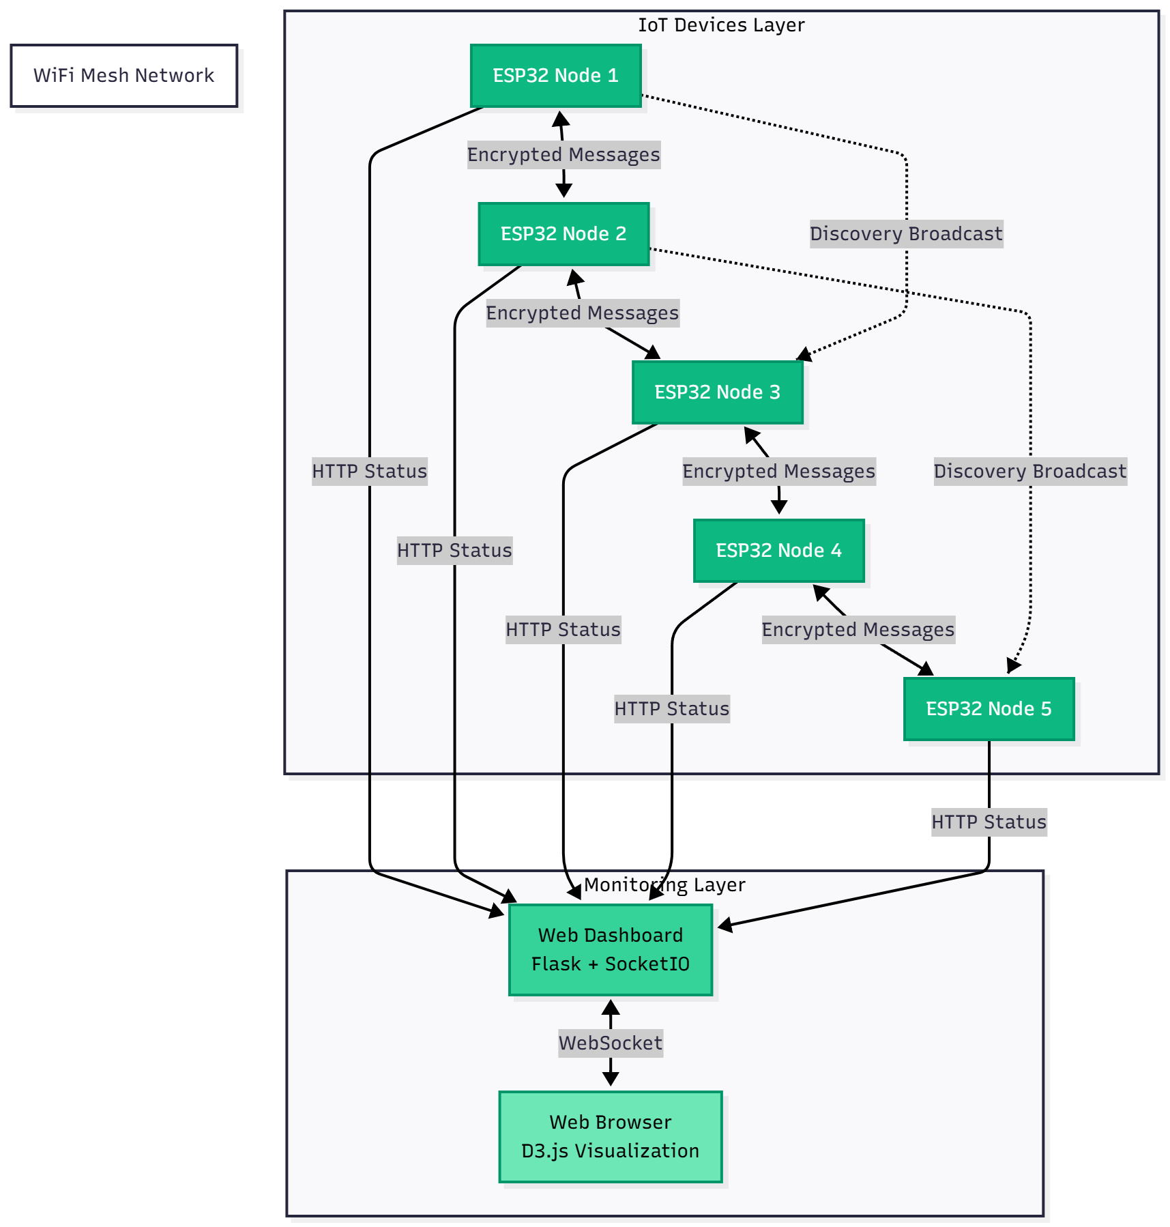
Architecture
Overview
Every node stores only simple information:
Nearby node IDs
Their IPs
Last-seen time
Optional hop-distance
Nodes get shared key → Nodes discover → build neighbor lists
→ encrypt data → hop data through the mesh
→ reject unknown devices

Slide 9
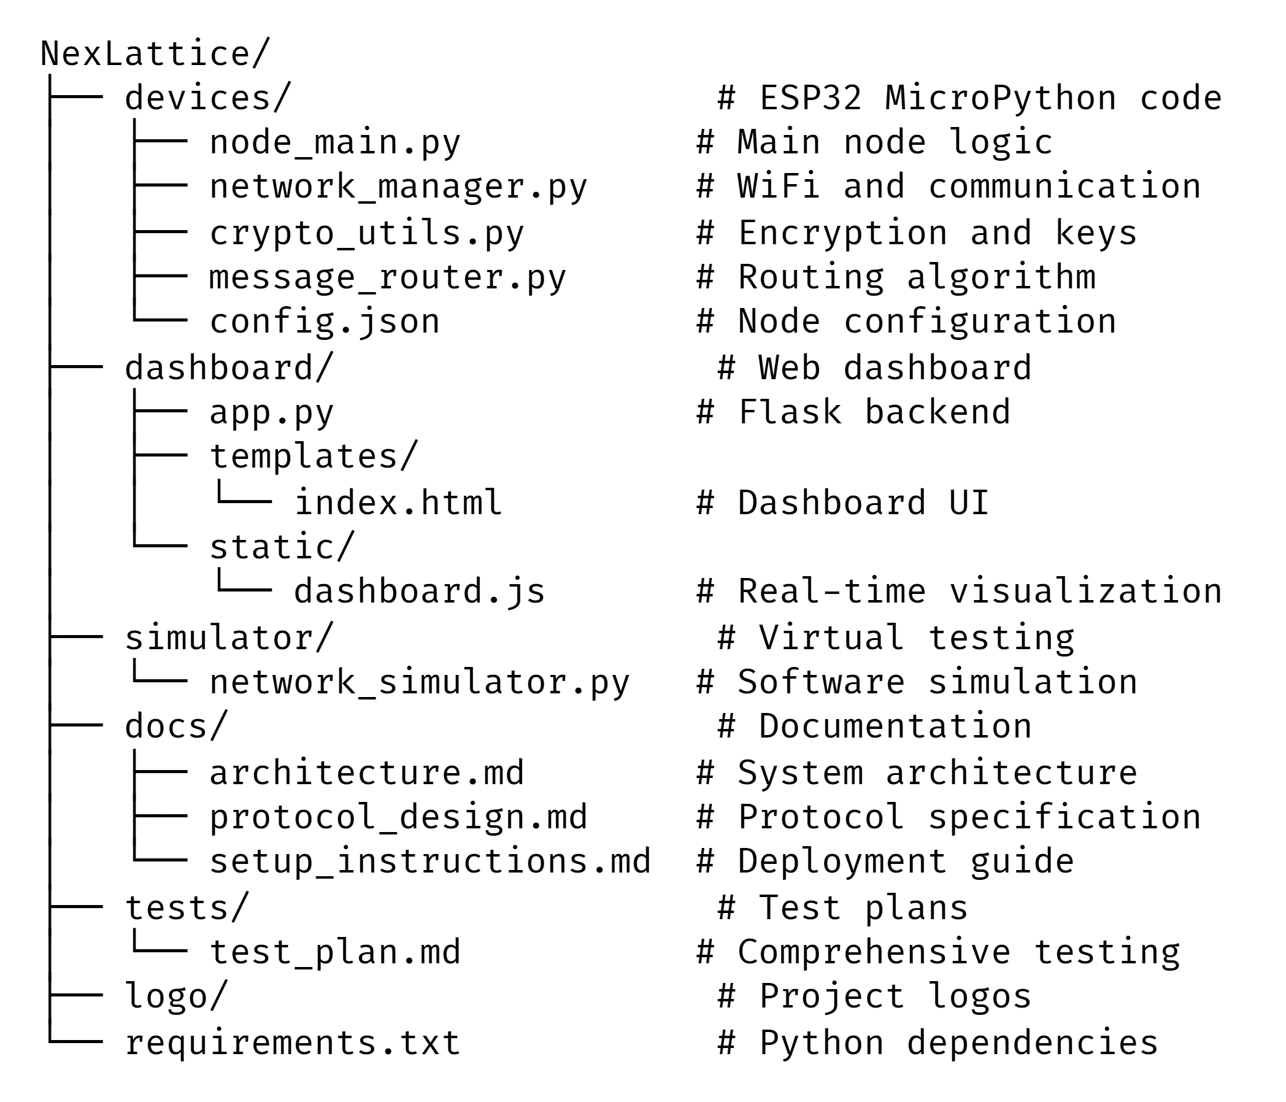
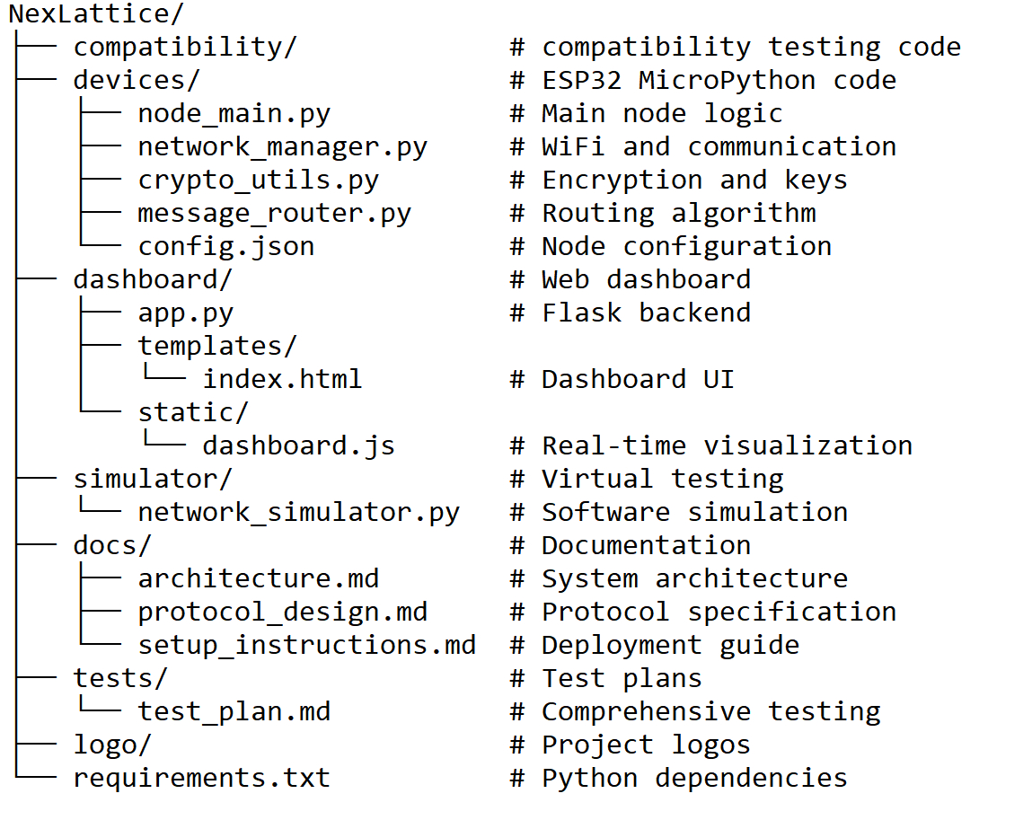
Project Structure

Slide 10
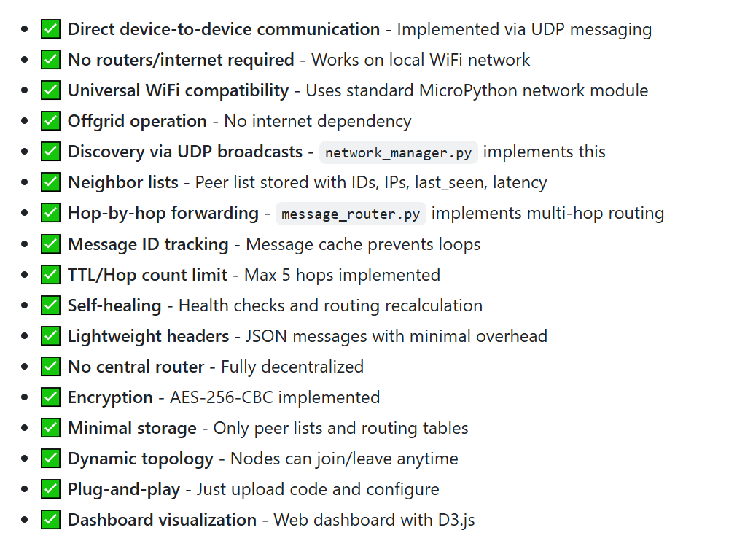
Core Functionality

Slide 11
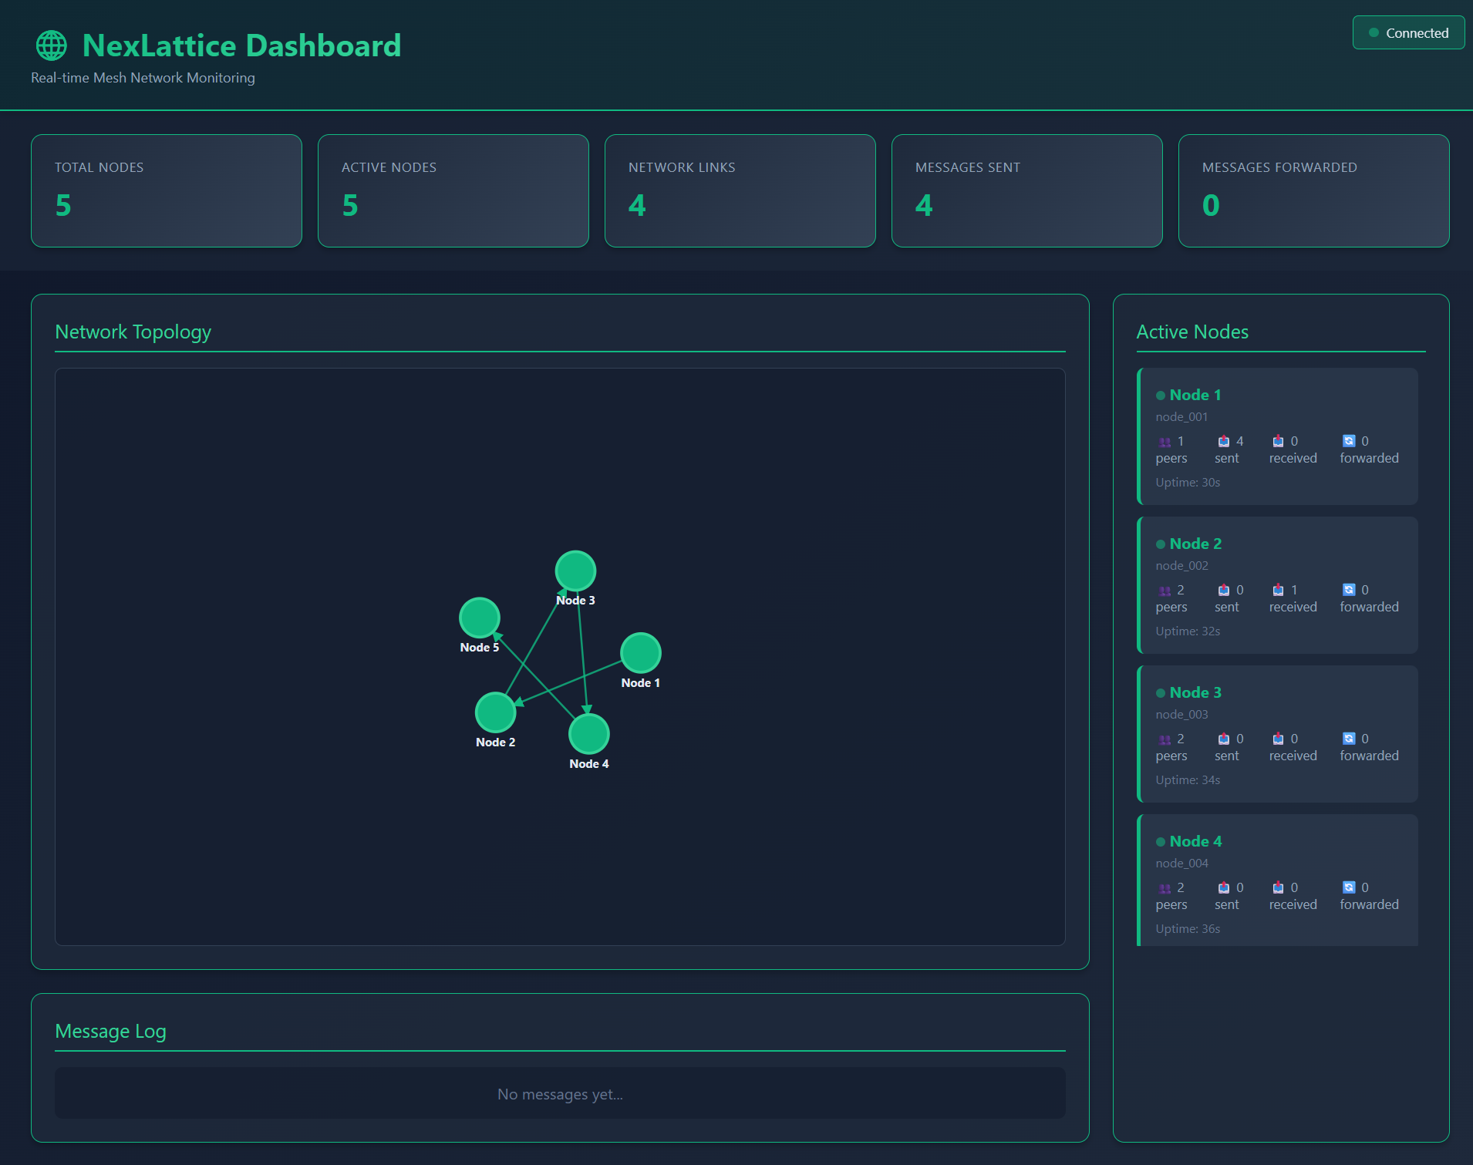
Dashboard

Slide 12
References
[1] J. M. Solé, R. P. Centelles, F. Freitag, R. Meseguer, and R. Baig, “Middleware for Distributed Applications in a LoRa Mesh Network,” ACM Transactions on Embedded Computing Systems, vol. 24, no. 4, Art. 60, pp. 1– 26, Jul. 2025. doi: 10.1145/3747295
[2] R. Berto, P. Napoletano, and M. Savi, “A LoRa-Based Mesh Network for Peer-to-Peer Long-Range Communication,” Sensors, vol. 21, no. 13, p. 4314, Jul. 2021. doi: 10.3390/s21134314
[3] N. L. Giménez et al., “Embedded Federated Learning over a LoRa Mesh Network,” Pervasive and Mobile Computing, vol. 91, p. 101819, 2023. doi: 10.1016/j.pmcj.2023.101819
[4] Z. Sun et al., “Recent Advances in LoRa: A Comprehensive Survey,” ACM Computing Surveys, vol. 55, no. 12, Art. 243, pp. 1–35, Dec. 2022. doi: 10.1145/3543856
[5] W. Wang, G. He and J. Wan, "Research on Zigbee wireless communication technology," 2011 International Conference on Electrical and Control Engineering, Yichang, China, 2011, pp. 1245-1249, doi: 10.1109/ICECENG.2011.6057961.
[6] J. Bicket, D. Aguayo, S. Biswas, and R. Morris, “Architecture and Evaluation of an Unplanned 802.11b Mesh Network,” in Proc. of MobiCom 2005, Cologne, Germany, Sep. 2005.
[7] Espressif Systems, “ESP-MESH: Networking Solution Based on ESP32,” 2020. [Online]. Available: https://docs.espressif.com
[8] S. Sicari, A. Rizzardi, L. A. Grieco, and A. Coen-Porisini, “Security, Privacy and Trust in Internet of Things: The Road Ahead,” Computer Networks, vol. 76, pp. 146–164, 2015.
[9] E. Fernandes, J. Jung, and A. Prakash, “Security Analysis of Emerging Smart Home Applications,” in Proc. of IEEE Security and Privacy (SP), San Jose, CA, 2016.
[10] C. M. Ramya, M. Shanmugaraj and R. Prabakaran, "Study on ZigBee technology," 2011 3rd International Conference on Electronics Computer Technology, Kanyakumari, India, 2011, pp. 297-301, doi: 10.1109/ICECTECH.2011.5942102.
[11] A. N. A. A. Aziz, R. A. Rashid, M. N. M. Nasir and M. A. Sarijari, "ESP Mesh Network for Security Application," 2024 IEEE International Conference on Advanced Telecommunication and Networking Technologies (ATNT), Johor Bahru, Malaysia, 2024, pp. 1-4, doi: 10.1109/ATNT61688.2024.10719207.

Slide 13
Thank You

